Slide 1

Common Chart Types and Use Cases
Stock Charts
Heat Maps
Surface Charts

Slide 2
The Practice Excel File
In this section, open the “Excel-Part 5.xlsx” file and generate plots for each sheet.

Slide 3
Stock Charts
Used for: Visualize stock market data
Key Metrics:
Volume
High, Low, Open, and Closing prices
Pro Tips:
Manually set min/max values for readability (default min=0 can be misleading).
Switch from date to text to eliminate gaps (e.g., weekends with no trading).

Slide 4
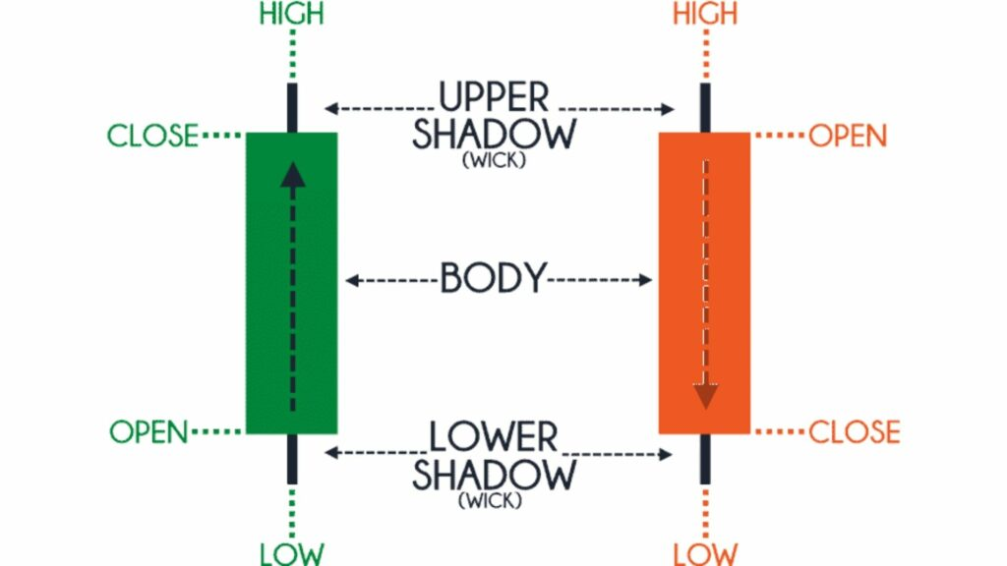
Anatomy of a Candlestick Chart
Body:
Represents the range between Open and Close prices.
Green: Close > Open (Price rose).
Red: Close < Open (Price fell).
Upper Shadow (Wick):
Shows the highest price reached during the period.
Lower Shadow (Wick):
Shows the lowest price reached during the period.
Reference: https://analyzingalpha.com/open-high-low-close-stocks

Slide 5
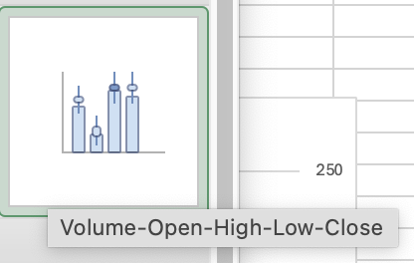
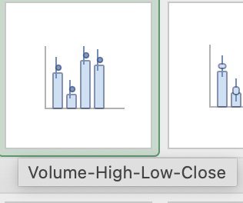
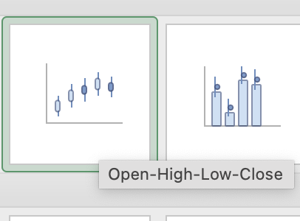
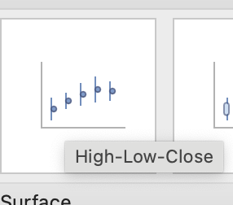
Building a Stock Chart
Steps:
Select data in order (e.g., Volume-Open-High-Low-Close).
Insert correct chart type (only matches specific data).
Format for clarity:
Adjust axis min/max (e.g., secondary price axis min=80).
Change date labels (e.g., show only day/month).
Switch x-axis to text to remove weekend gaps.

Slide 6
Practice: Tesla Stock Chart

Slide 7
Heat Maps With Conditional Formatting
Used for:
A color-based visualization to highlight patterns in data.
Uses gradient colors to represent values (e.g., high = red, low = blue).
Example Use Cases:
Accident rates by time/day
Average temperature by city & month
Key Benefit:
Instantly spot trends without complex charts.

Slide 8
How to Build a Heat Map in Excel
Select Data Range (e.g., temperature table).
Apply Conditional Formatting:
Go to: Home → Conditional Formatting → Color Scales.
Choose a preset (e.g., Blue-Red for hot/cold).
Customize:
Adjust min/max thresholds (Manage Rules).
Use three semicolons (;;;) in Custom Formatting to hide cell values but keep colors.
Pro Tip:
Use intuitive color scales (e.g., red = hot, blue = cold).
Apply ;;; formatting to hide numbers (Select the cells with your data, Right-click → Format Cells → Custom, In the Type field, enter: ”;;;” , Click OK—values disappear, but color formatting remains!

Slide 9
Practice: Average Temperature Heat Map
 | Anchorage | Boston | New York City | Chicago | Denver | Dallas | Miami | Phoenix | Auckland | Sydney
Jan
Feb
Mar
Apr
May
Jun
Jul
Aug
Sep
Oct
Nov
Dec

Slide 10
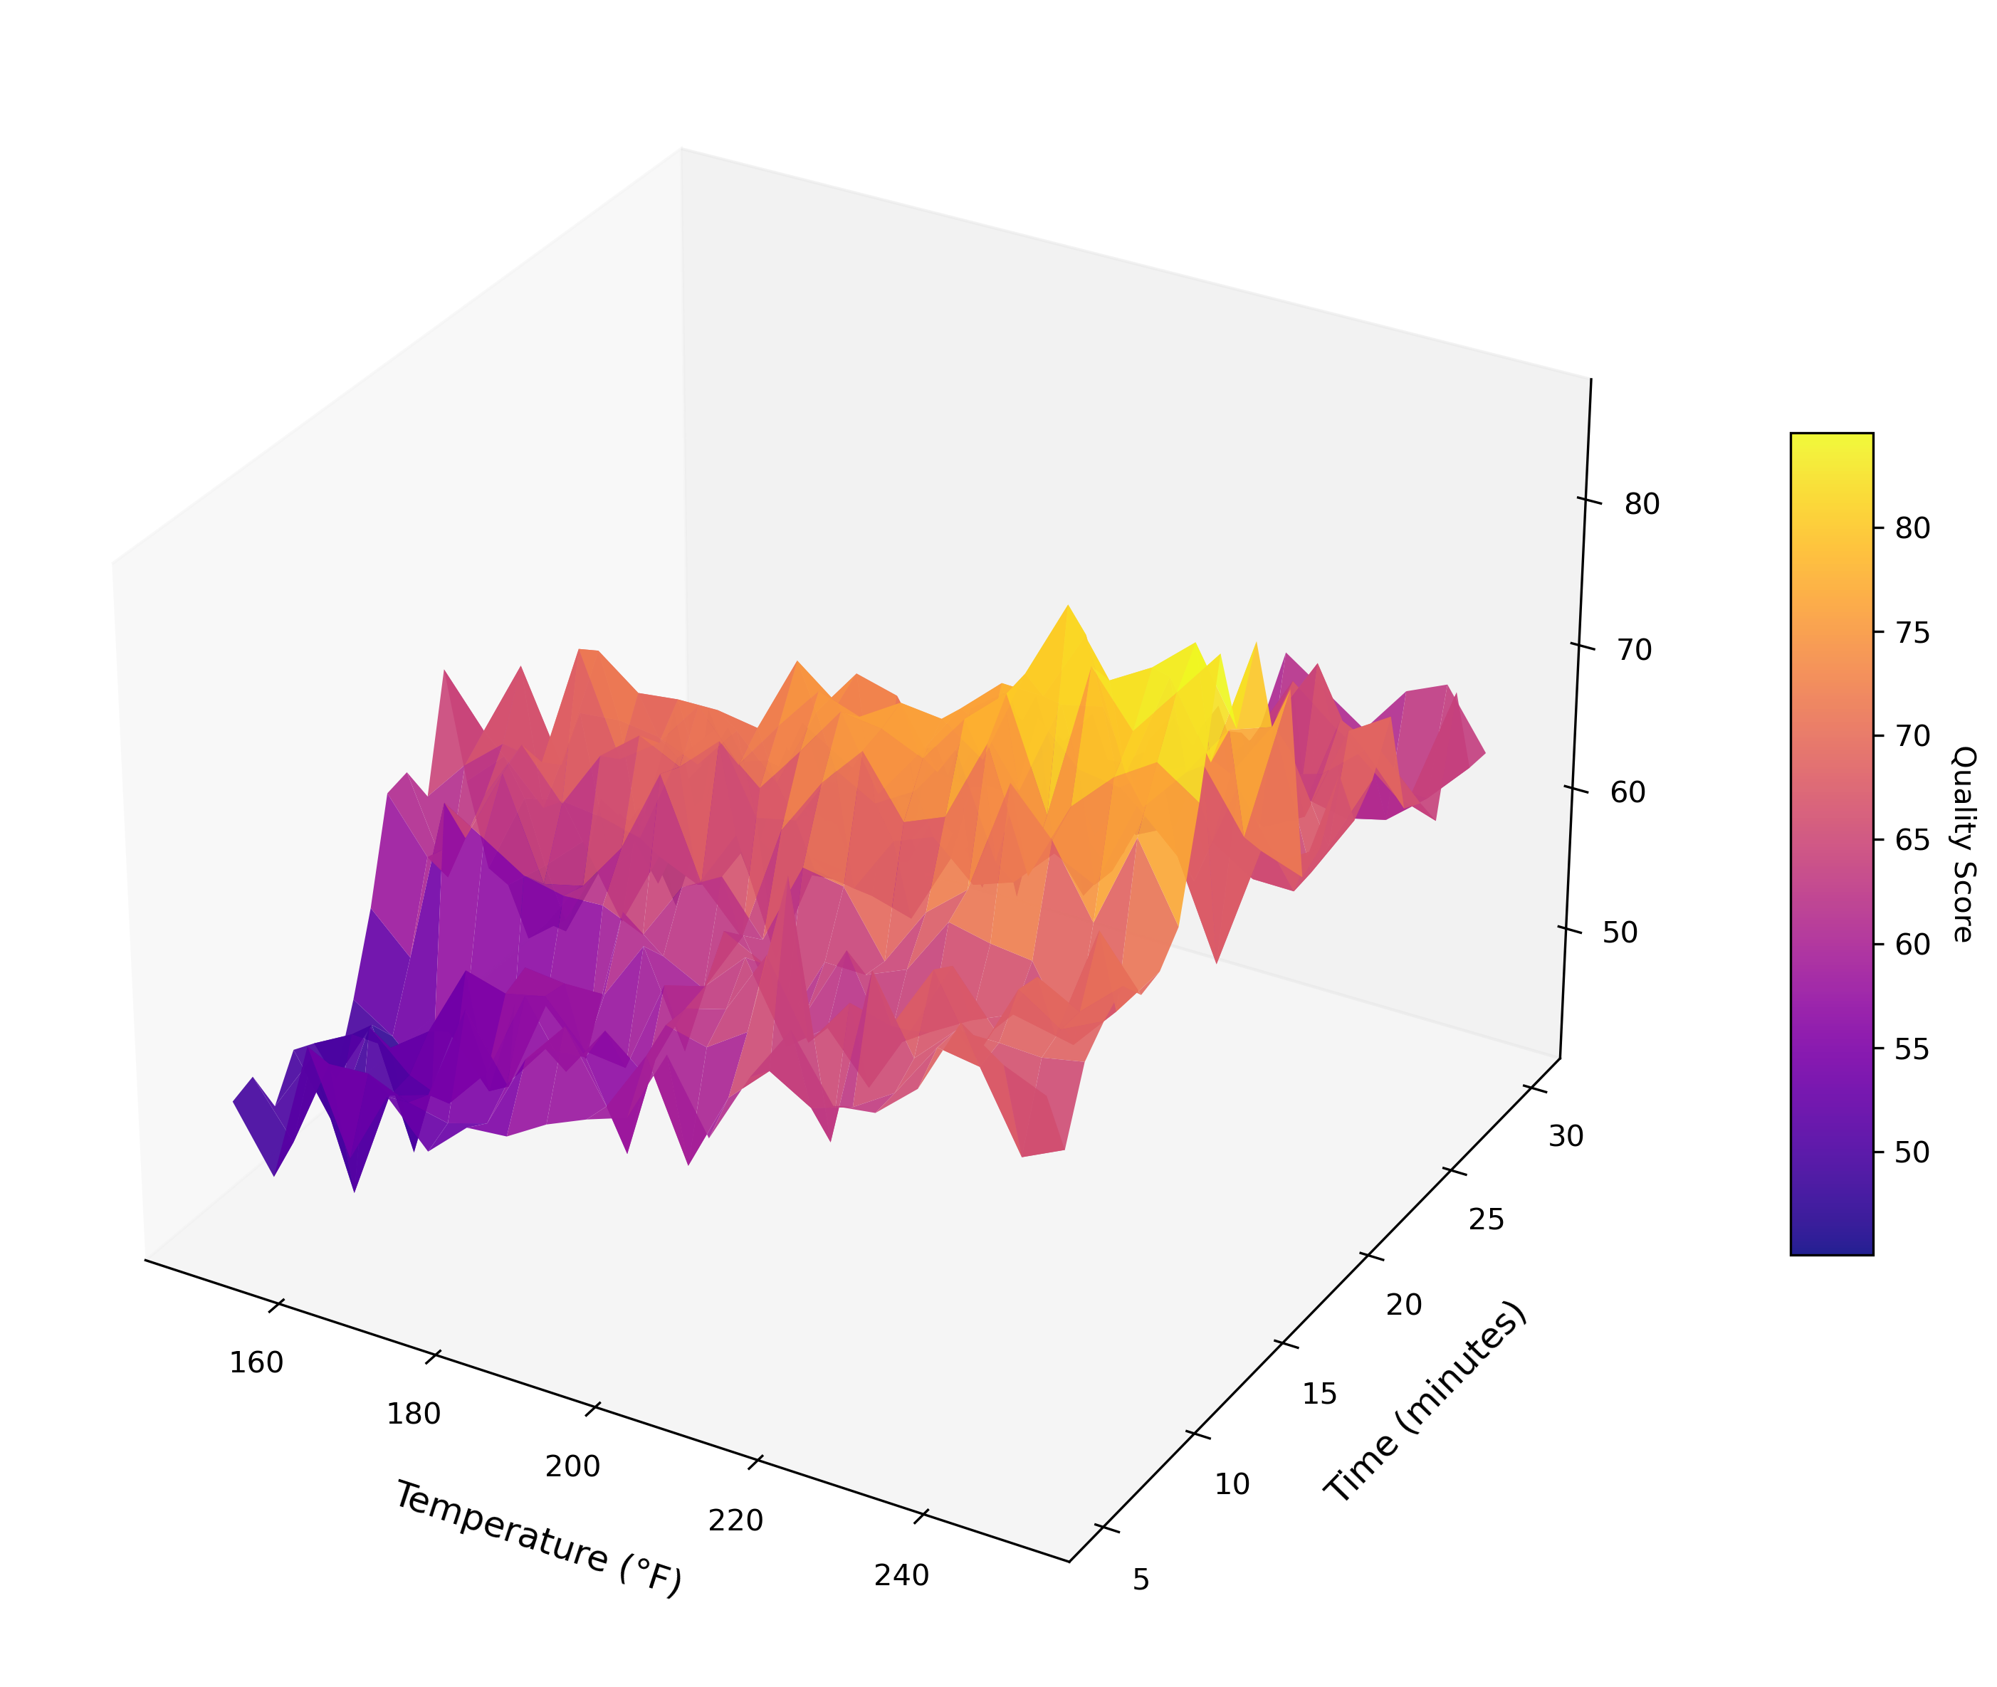
Surface Charts: Visualizing 3D Data for Optimal Insights
Example: Finding the optimum cooking time vs. temperature vs. outcome.

Slide 11
What Are Surface Charts?
Plot data in 3 dimensions (X, Y, Z) to show depth.
Ideal for finding optimum combinations (e.g., time vs. temperature vs. outcome).
Cool-looking but use judiciously—simpler charts may suffice.

Slide 12
Building a Surface Chart in Excel
Select data: Include row/column labels (e.g., accident frequency matrix).
Insert: Insert > Surface Chart (choose 3D or contour).
Label axes:
X: Hour of day
Y: Accident frequency
Z: Day of week

